Slide 1
Dive Log Assistant
Alex Engel

Slide 2
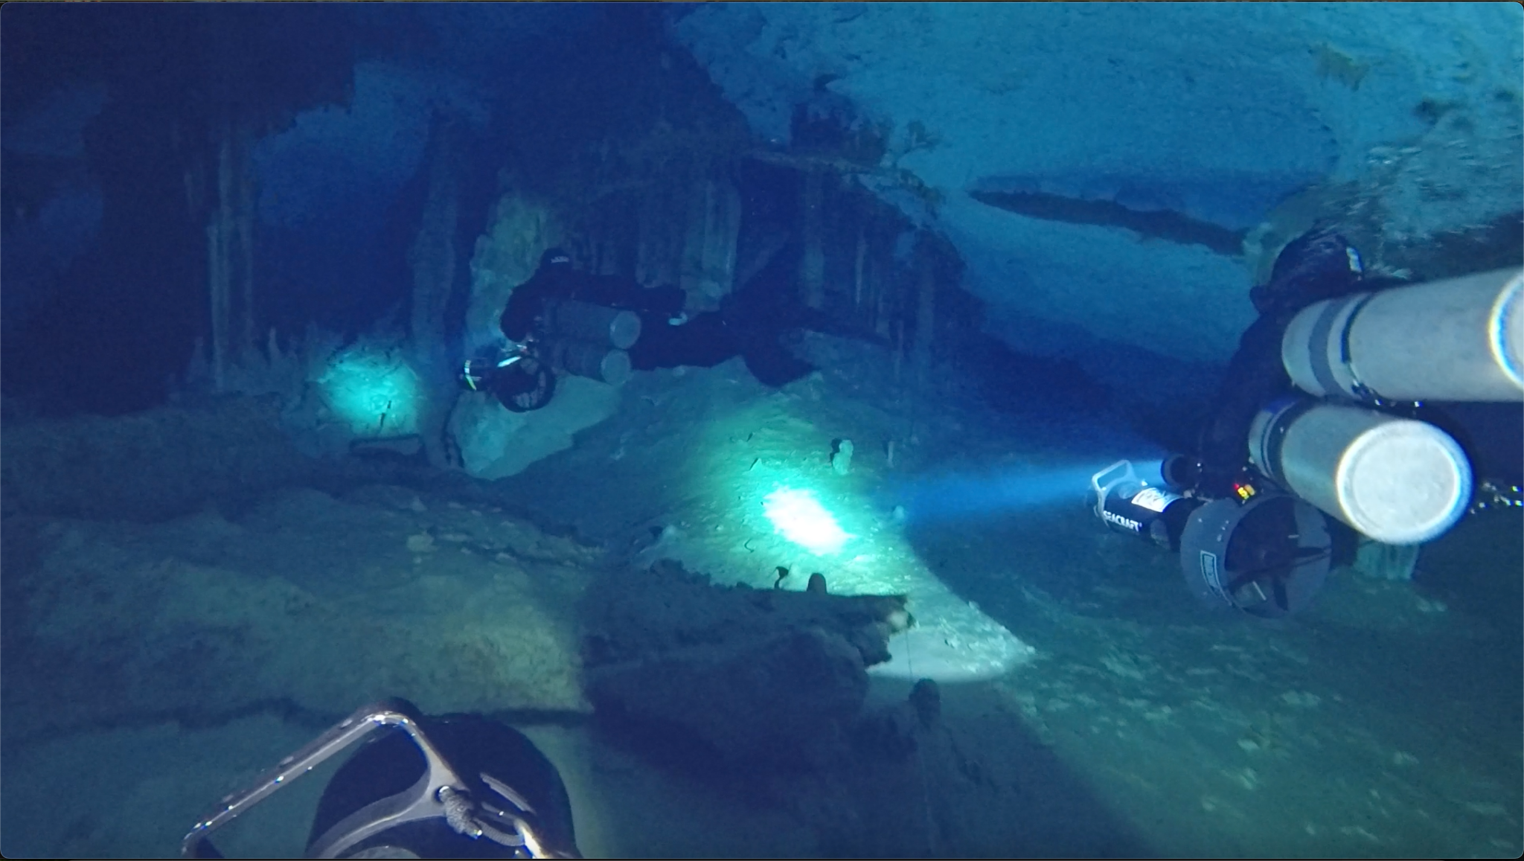
Overview
Problem Space
Solution
Key Design Choices
Demo
Next Steps

Slide 3
Problem Space
What is a dive log?
Why log your dives?
May be required for future certifications
Keep track of equipment used for certain scenarios
Plan future dives
Challenges with logging dives
Must be done very soon after a given dive (memories fade)
Instructors (and some non-pro divers) accumulate many thousands of dives
Traditional dive logs make it difficult to search and retrieve information

Slide 4
Solution
Dive log assistant!
Easily log dives using real language
Easily search and analyze dive logs to:
Generate statistics across multiple dives
Remind yourself where you saw that one special thing
Get equipment recommendations for a given scenario
More engaging than a traditional dive log
Remembers preferences like your name and preferred units

Slide 5
Key Design Choices
Powered by GPT-4.1
Cost-effective due to relatively low cost-of-output, esp. considering inputs will usually be small and outputs will be large.
Low latency when compared to reasoning models like GPT-5.1, better for chat
Better output than other non-reasoning models like 4.1-mini, etc.
Improved formatting
More likely to get calculations correct
Better puns
Autogen Framework
Create agents
Provide memory to agents
Function tools

Slide 6
Key Design Choices (cont.)
MCP tools
Search dives (by metadata or full-text)
Get all dives
Create a dive log entry
Persist memory
SQLite DB
Good for prototyping
Maybe not so great for FTS

Slide 7
Demo

Slide 8
Known areas for improvement
The agent does not always call the “get_all_dives” tool when performing aggregations. Sometimes it says it will perform the aggregation but does not actually do so
Better support for units. The agent is ok at remembering to convert but it will often state the metric unit first, followed by imperial even if the preferred units are imperial.
Probably due to storing units in metric
Maybe provide an MCP tool for converting units?
Evaluations
Evaluated by hand for the prototype
Use something like LangSmith to compare outputs across models, system prompts, etc.
Observability
Implement traces, improved logging, etc.
SQL structure is messy, esp. when considering FTS. Okay for prototyping but would need to be improved for productionizing.

Slide 9
Next Steps
Dive planning agent
Use RAG to provide a contextual knowledge base of personal dive planning considerations via vector DB like Pinecone or similar
Use a reasoning model like GPT-5.1 to better ensure a comprehensive, safe dive plan
Integrate with existing MCP tools to provide knowledge of similar dives, equipment used, etc.
Orchestration
Supervisor agent will handoff to either the dive log agent or dive planning agent depending on the user’s query
Multi-user support

Slide 10
Thank you!

